Slide 1
I399 Web Design
Lab 7

Slide 2
PROJECT 4 PRACTICE
Today we’re going to finish our Rainbow Bakery design exercise.
http://rainbowbakery.net/menu
The goal in this case is to mimic their look.. You’re getting closer to being able to design pages that look like real websites!

Slide 3
PROJECT 4 PRACTICE
If you didn’t complete everything asked for last lab, you can practice those pieces on your own.
Today, please start with Project 4 Practice Part Two, which is a completed version of the tasks asked in the last lab.

Slide 4
SET UP THE FILES
Download Project 4 Practice Part Two
Open index.html in Chrome or Firefox
Open the code in your favorite text editor
NOTE:
The main part of the page has already been designed.
Today we will layout the header, navigation and footer.

Slide 5
STRUCTURE
Reminder
We’re working on header, nav and footer today.
For this design, nav is within the header. Our footer will contain social media icons.
header
nav
main
H1
section
figure
figure
section
figure
figure
section
figure
figure
footer

Slide 6
NOW, WORK THROUGH EACH ITEM IN THE CSS
Directions are in the slides.
Feel free to ASK AN AI to take a look at each section or to go over the structure with you.
Do your best to mimic the screenshots provided.

Slide 7
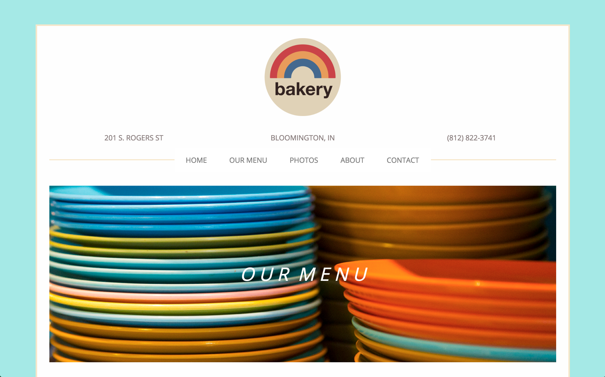
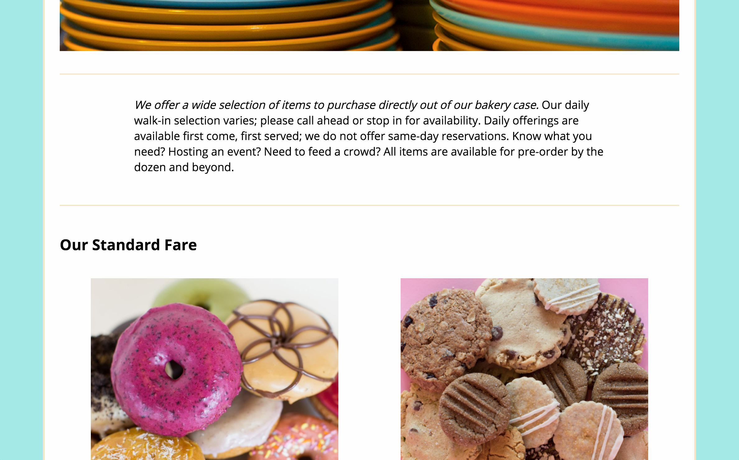
HEADER • HTML
Add an h1 that says “Rainbow Bakery”
Add an image (logo.png), give it the class “logo”
Then HIDE the h1 using the sr-only class from our Code Snippets page.

Slide 8
HEADER • HTML
Add the address as an address tag. Use a p around each line (nest the p tags under address).
201 S. Rogers St
Bloomington, IN
(812) 822-3741

Slide 9
HEADER • HTML
Create a nav section within header.
Add an unordered list of links (link to pages, but we won’t create.. Ex. <a href=”about.html”>About</a>):
Home
Our Menu
Photos
About
Contact

Slide 10
HEADER • CSS
First, one change.. Because the header and nav are in main in this design, we either have to MOVE main and create a new container to hold our site, OR we have to be more specific with the styles we created last time.
Let’s just be more specific.
In “Main” (CSS line 70), notice that I changed the comment to be for “Article” and adjust the references to be for “article”.

Slide 11
HEADER • CSS
First, let’s control the logo.
Give it a width of 150px, so it’s not too big. (The height will usually adjust automatically by default.)
Turn the image into a block element, and center it.
Give the logo 2.0em padding on the bottom, but none on the top, right or left.
Make sure you’re styling ONLY the image in the header.

Slide 12
HEADER • CSS
Next, structure the address:
This is the flex container
Row, wrap
Justify with space between
Then, give it some styling:
2.0em padding on the bottom
A solid 2px border on the bottom using the color #F6E6CA
Transform all the text to uppercase

Slide 13
HEADER • CSS
Style/structure the p items:
Grow and shrink are okay, but set the basis to 250px (Comment this out again to see what happens if you don’t adjust when items wrap)
Take off the margin and padding completely, but do increase the line height to 1 1/2 lines (1.5em)
Text color is #8b7f7f
Take the italics off
Center the text
Decrease font size to 14px

Slide 14
HEADER • CSS
The header should look good now! Let’s add the navigation:
The CSS for the navigation is located in nav.css
Link this stylesheet as a resource in the head of the HTML
Read through the comments in nav.css and take a moment to understand before moving on.
This is the most traditional method for creating a menu. It floats each li and uses the a as a block to create a button effect. Also notice the media query that helps the menu look better on a mobile screen.

Slide 15
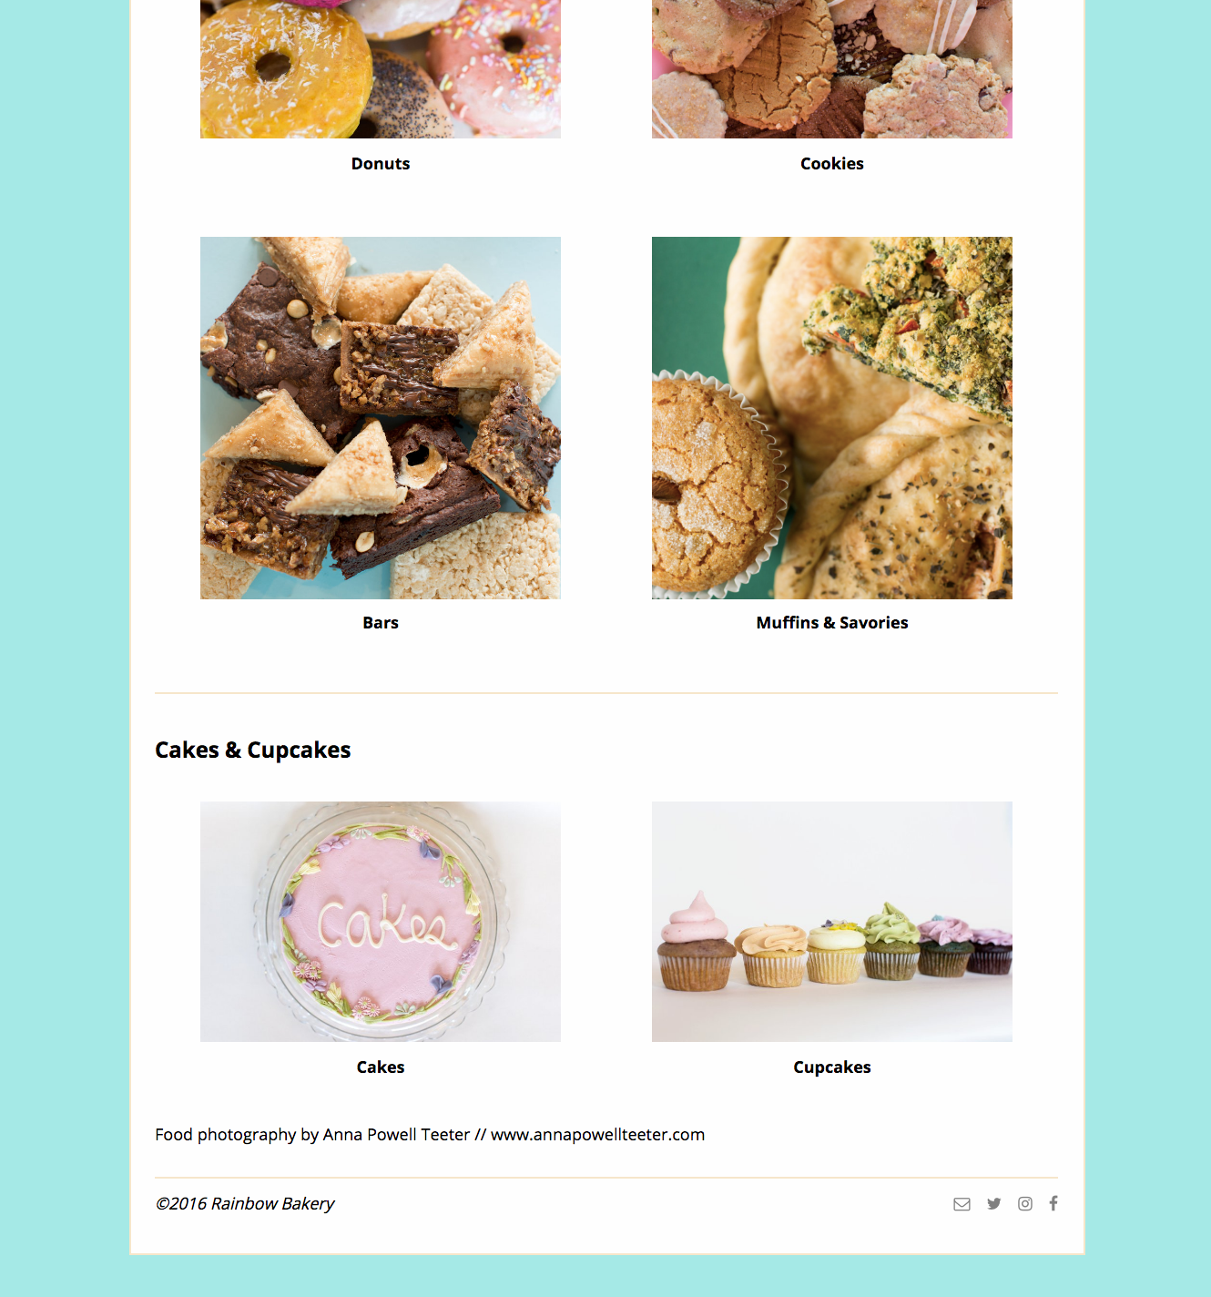
FOOTER • HTML
The footer is very simple in this design.. Just a copyright and few social media icons:
Add a <small> with copyright information (Use a HTML special character for this.)
Using Font Awesome, add icons for Email, Twitter, Instagram and Facebook. The script tag in head has already been added for you.
Make these icons into links that go nowhere, ex. <a href=”#”> </a>

Slide 16
FOOTER • CSS
Adjust the footer container:
Italic font
2.0em margin on the top, but none on bottom or either side
2px solid border on the top only, colored a lovely #F6E6CA
1.0em padding on the top and bottom, but none on the left/right
We need to both push the footer away from the section above, and push the content away from the border.

Slide 17
FOOTER • CSS
Adjust the footer icons:
float the icons on the right
Create space between the icons by adding 1.0em of margin on the left of each icon

Slide 18
Finished?
Upload a screenshot to Canvas with how far you were able to get today.. We’re looking for you to have attempted this..
If you didn’t finish, then work on it on your own and compare to the posted solution (it will be up by Sunday). Please go to AI office hours if you need extra help.

